Slide 1

Week-2
Lecture 2

Slide 2
Lecture Contents
Access Specifiers: Public , Private, Protected
Scope Resolution Operator allocation

Slide 3
Access Specifiers in C++
Access modifiers are used to implement an important feature of Object Oriented Programming known as Data Hiding.
Real-life example: Webkiosk
Some restrictions on the class members not to get directly accessed by the outside functions

Slide 4
Access Specifiers in C++
3 types of access modifiers available in C++:
Public
Private (by default)
Protected

Slide 5
Access Specifiers in C++
Public:
All class members available to everyone.
Data members and member functions can be accessed by other classes.
Public members can be accessed in the program by using access operator (.) or (->) with the object of that class.

Slide 6
Access Specifiers in C++
Private:
Private Class members can be accessed only by the functions inside the class.
Not allowed to be accessed directly by any object or function outside the class.
Only the member functions or the friend functions (outside class) are allowed to access the private members of a class.

Slide 7
Access Specifiers in C++
Protected:
Protected access modifier is similar to that of private access modifiers.
Difference is that the class member declared as Protected are inaccessible outside the class.
but they can be accessed by any subclass(derived class) of that class.

Slide 8
Access Specifiers in C++
class Base
{
public:
// public members go here
protected:
// protected members go here
private:
// private members go here
};

Slide 9
Access Specifiers in C++
class Base
{
public:
// public members go here
protected:
// protected members go here
private:
// private members go here
};

Slide 10
Scope Resolution Operator
      1. Member functions defined outside class
  Using Binary scope resolution operator (::)
  “Ties” member name to class name
  Uniquely identify functions of particular class
  Different classes can have member functions with same name
  Format for defining member functions
    ReturnType ClassName::MemberFunctionName( ){
    …
    }

Slide 11
Access Specifiers in C++
class Circle{
private:
double radius;
public:
Circle() { radius = 0.0;}
Circle(int r);
void setRadius(double r){radius = r;}
double getDiameter(){ return radius *2;}
double getArea();
double getCircumference();
};
Circle::Circle(int r){
radius = r;
}
double Circle::getArea(){
return radius * radius * (22.0/7);
}
double Circle:: getCircumference(){
return 2 * radius * (22.0/7);
}

Slide 12
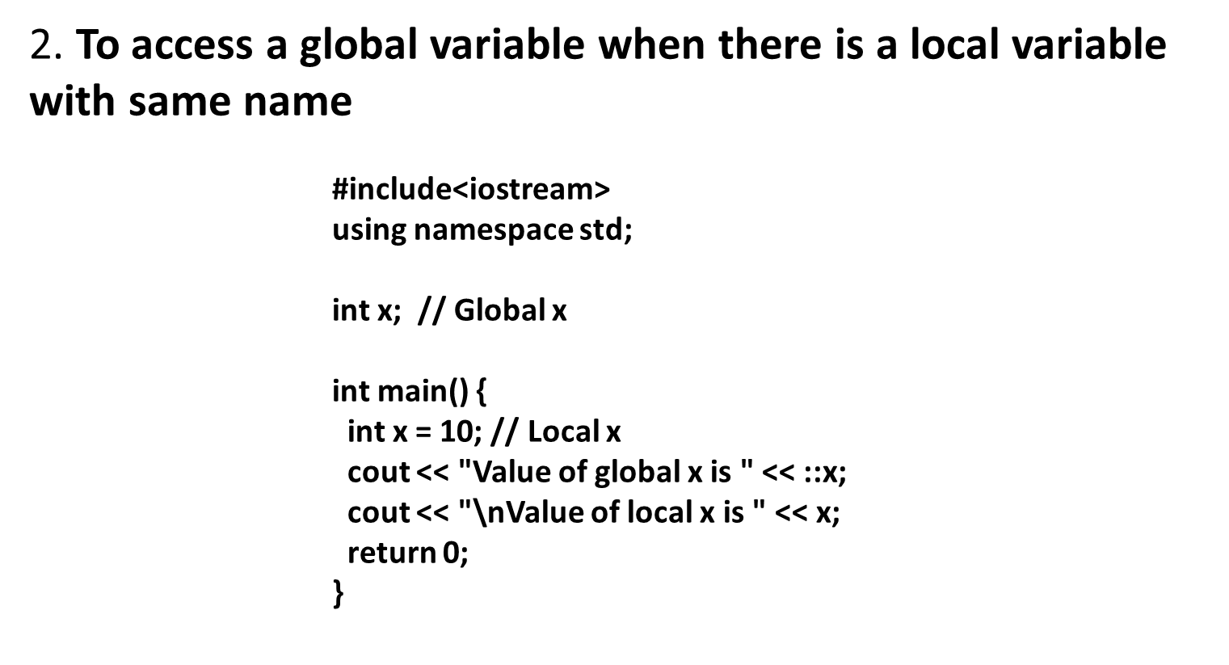
Scope Resolution Operator

Slide 13
Scope Resolution Operator
      3. To access a class’s static variables
      class Test {
      static int x;
      public:
      static int y;
      void func(int x) { // We can access class's static variable even if there is a local variable
      cout << "Value of static x is " << Test::x;
      cout << "\nValue of local x is " << x;
      }
      };
      int Test::x = 1; // In C++, static members must be explicitly defined like this
      int Test::y = 2;
      int main() {
      Test obj;
      int x = 3 ;
      obj.func(x);
      cout << "\nTest::y = " << Test::y;
      return 0;
      }

Slide 14
Scope Resolution Operator
      4. In case of multiple Inheritance
      If same variable name exists in two ancestor classes, we can use scope resolution operator to distinguish.
      Detail would be discussed in inheritance………………

Slide 15
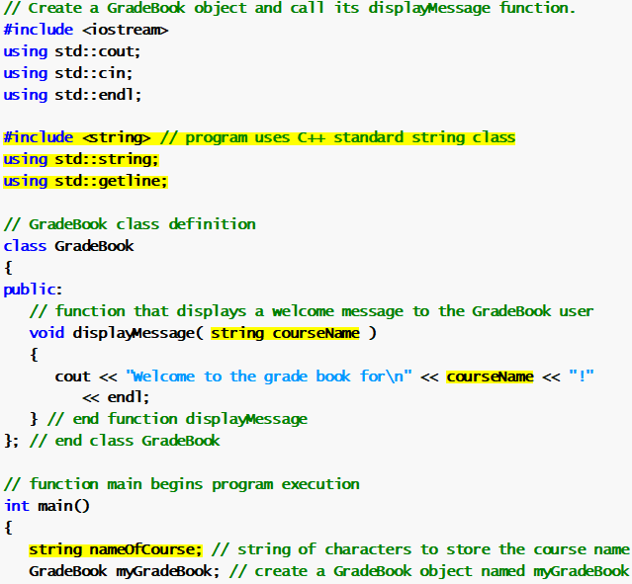
Scope Resolution Operator
      5. Including In-built libraries.

Slide 16
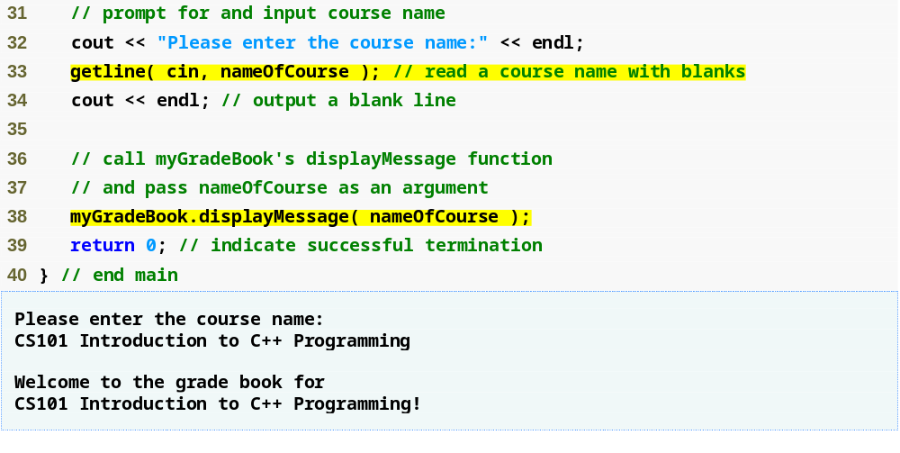
Scope Resolution Operator
      5. Including In-built libraries.

Slide 17
Thank You

